Slide 1
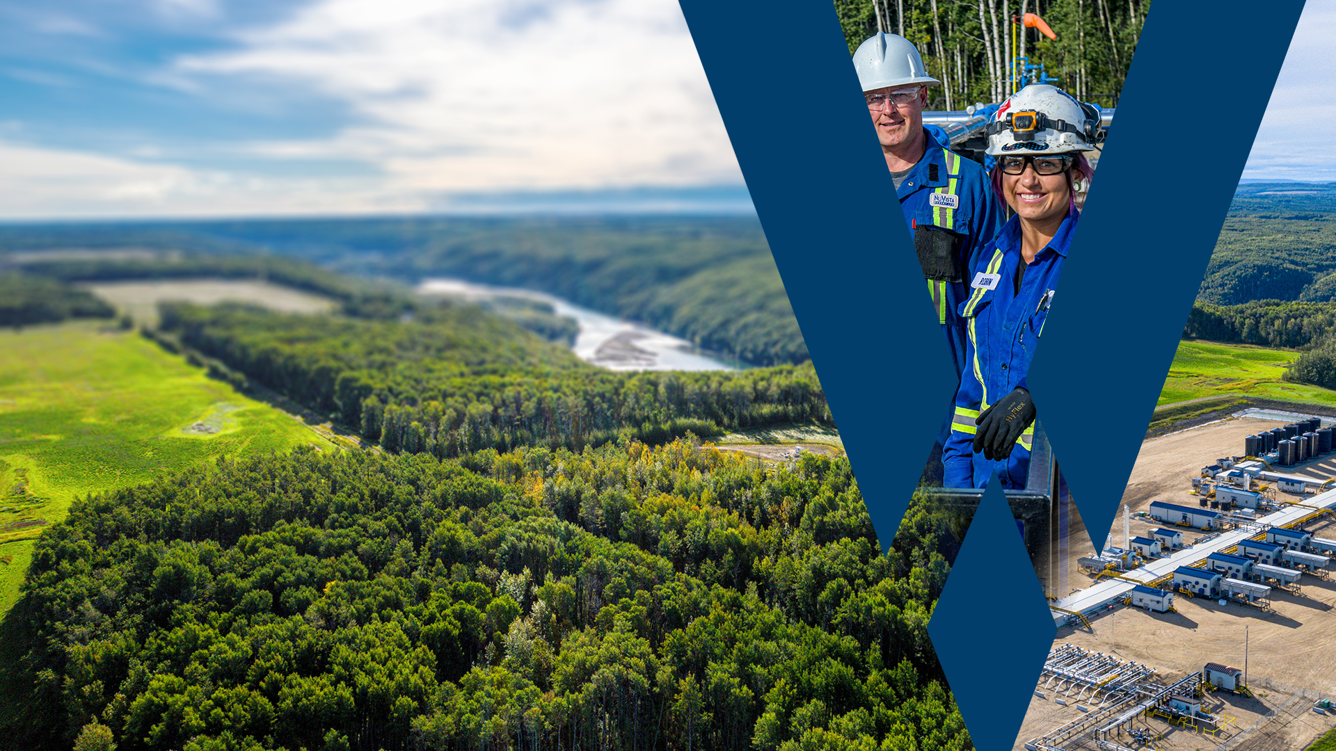
Frac Hits near Fiber
Feb 19 2025

Slide 2

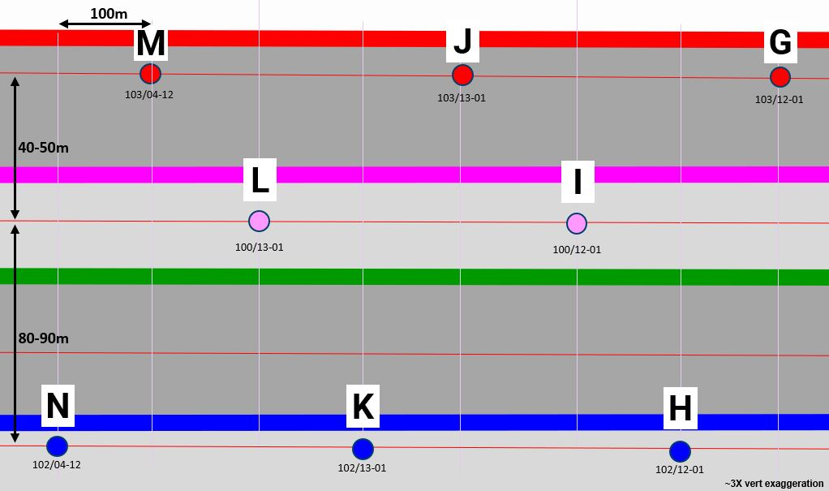
J-Well

Slide 3

K-Well

Slide 4

L-Well

Slide 5

M-Well

